Slide 1

Welcome to the Tidyverse
Charlie Murtaugh
EIHG 4420B
801-581-5958
murtaugh@genetics.utah.edu
https://twitter.com/mostbiggestdata/status/1033725572462137344

Slide 2

Recommended reading
R for Data Science – full text is free on web, but book is easier to read
H. Wickham (2014) Tidy Data. J. Stat. Software. v59. http://dx.doi.org/10.18637/jss.v059.i10
K.W. Broman and K.H. Woo (2018) Data Organization in Spreadsheets. Am. Statistician, v72. https://doi.org/10.1080/00031305.2017.1375989

Slide 3
Outline
Introduction to tidy data and the Tidyverse – why bother?
Getting started with Tidyverse functions – playing with toy data sets
Using Tidyverse in a real biology context –proliferation timelapse data

Slide 4

What is the tidyverse?
Collection of packages and functions designed to enhance visualization and analysis of data, as well as simplify writing and reading R code
Installing “tidyverse” package brings along all key sub-packages including ggplot2, dplyr, magrittr, stringr, readr
Key concept: tidy data
Hadley Wickham
Chief Scientist, RStudio

Slide 5
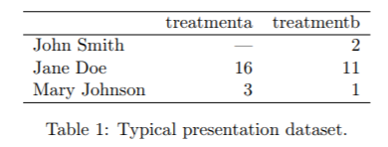
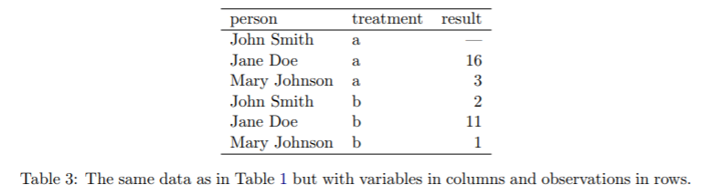
Tidy data
Wickham’s concept:
In tidy data:
Each variable forms a column.
Each observation forms a row.
Each type of observational unit forms a table.
Wickham, J. Stat. Software 2014

Slide 6
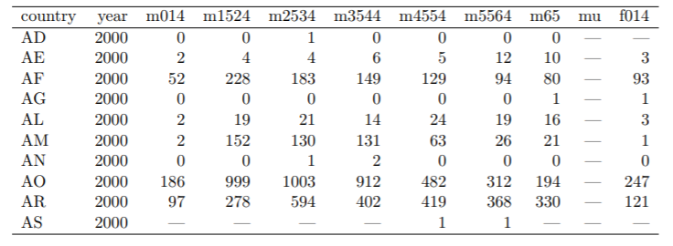
Usefulness of tidy data
WHO tuberculosis cases per country, broken down by gender and age of patients
Original dataset (“top left corner” of large spreadsheet)
Wickham, J. Stat. Software 2014

Slide 7
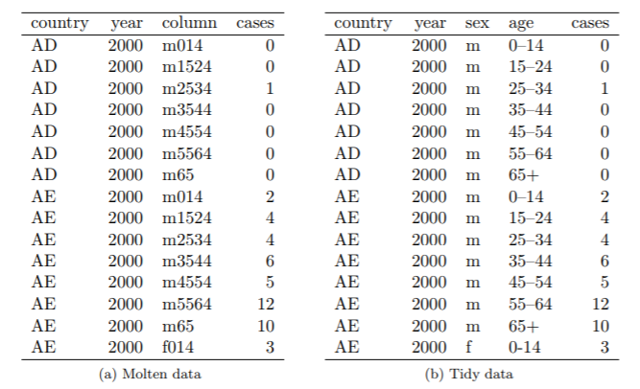
Usefulness of tidy data
Tidied dataset
aka “narrow” data
(tidyverse gather() function)
Wickham, J. Stat. Software 2014

Slide 8
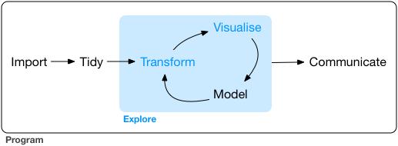
Tidy data approach
Exploratory data analysis – tools for easily examining and visualizing your data, developing approaches for statistical analysis, potentially changing your data-gathering (experimental) methods

Slide 9
Getting started with Tidyverse functions
%>% “pipe” output from one function to another
gather convert spreadsheet-type data to tidy format
separate split up single descriptor variable (e.g. spreadsheet
column head) into multiple variables
group_by organize data according to descriptor variables
summarize extract summary information from grouped data
filter isolate subsets of data

Slide 10
Creating a toy dataset – tibble format
library(tidyverse)
library(cowplot)
temp_df <- bind_cols(sample=c(1,2,3), temp=c(-40, 32, 98.6)) %>%
print()
## # A tibble: 3 x 2
## sample temp
## <dbl> <dbl>
## 1 1 -40
## 2 2 32
## 3 3 98.6
tibbles are like data.frame objects, but they look nicer and display helpful information
note the use of the %>% operator, which “pipes” output of one function (bind_cols) to another (print)

Slide 11
Piping your code for easier writing and reading
# same result, different ways to get there
test <- c(1, 2, 3, 4)
test_sqrt <- sqrt(test)
print(test_sqrt)
c(1, 2, 3, 4) %>% sqrt() %>% print()
[1] 1.000000 1.414214 1.732051 2.000000
Code involving sequential operations on the same data can be much more readable with pipes
Of particular use: %>% print() at the end of a line of code will show you what that code produced

Slide 12
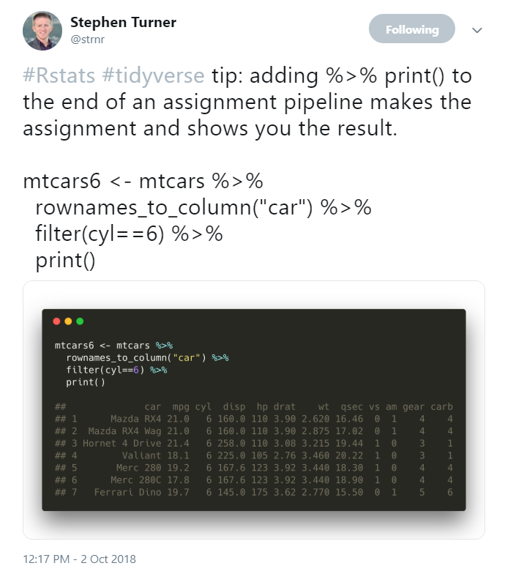
Piping your code for easier writing and reading
# same result, different ways to get there
test <- c(1, 2, 3, 4)
test_sqrt <- sqrt(test)
print(test_sqrt)
c(1, 2, 3, 4) %>% sqrt() %>% print()
[1] 1.000000 1.414214 1.732051 2.000000
Code involving sequential operations on the same data can be much more readable with pipes
Of particular use: %>% print() at the end of a line of code will show you what that code produced
https://twitter.com/strnr/status/1047203915232661505

Slide 13
Creating new columns or changing existing ones with mutate
# use "mutate" to create new column with temperature in Celsius
temp_df <- mutate(temp_df, tempC=(temp-32)*5/9) %>% print()
## # A tibble: 3 x 3
## sample temp tempC
## <dbl> <dbl> <dbl>
## 1 1 -40 -40
## 2 2 32 0
## 3 3 98.6 37
A nice trick of mutate: you can put multiple sequential operations into a single call, and even refer back to variables you just created in the same line of code

Slide 14
One mutate, multiple operations
# create toy data, again
temp_df <- bind_cols(time=c(1,2,3), temp=c(-40, 32, 98.6))
# now let's add both Celsius and Kelvin temperatures in one command
temp_df <- mutate(temp_df, tempC=(temp-32)*5/9,
tempK=tempC+273.15) %>%
rename(tempF = temp) %>%
print()
## # A tibble: 3 x 4
## time tempF tempC tempK
## <dbl> <dbl> <dbl> <dbl>
## 1 1 -40 -40 233.
## 2 2 32 0 273.
## 3 3 98.6 37 310.

Slide 15
Summarizing data with summarize – a toy example
data(mpg)
print(mpg) # just to check what the data look like
## # A tibble: 234 x 11
## manufacturer model displ year cyl trans drv cty hwy fl class
## <chr> <chr> <dbl> <int> <int> <chr> <chr> <int> <int> <chr> <chr>
## 1 audi a4 1.8 1999 4 auto… f 18 29 p comp…
## 2 audi a4 1.8 1999 4 manu… f 21 29 p comp…
## 3 audi a4 2 2008 4 manu… f 20 31 p comp…
## 4 audi a4 2 2008 4 auto… f 21 30 p comp…
## 5 audi a4 2.8 1999 6 auto… f 16 26 p comp…
## 6 audi a4 2.8 1999 6 manu… f 18 26 p comp…
## 7 audi a4 3.1 2008 6 auto… f 18 27 p comp…
## 8 audi a4 q… 1.8 1999 4 manu… 4 18 26 p comp…
## 9 audi a4 q… 1.8 1999 4 auto… 4 16 25 p comp…
## 10 audi a4 q… 2 2008 4 manu… 4 20 28 p comp…
## # … with 224 more rows
Let’s compare car models based on number of cylinders

Slide 16
group_by: organize data based on descriptor variable
mpg_by_cyl <- group_by(mpg, cyl) %>% print()
## # A tibble: 234 x 11
## # Groups: cyl [4]
## manufacturer model displ year cyl trans drv cty hwy fl class
## <chr> <chr> <dbl> <int> <int> <chr> <chr> <int> <int> <chr> <chr>
## 1 audi a4 1.8 1999 4 auto… f 18 29 p comp…
## 2 audi a4 1.8 1999 4 manu… f 21 29 p comp…
## 3 audi a4 2 2008 4 manu… f 20 31 p comp…
## 4 audi a4 2 2008 4 auto… f 21 30 p comp…
## 5 audi a4 2.8 1999 6 auto… f 16 26 p comp…
## 6 audi a4 2.8 1999 6 manu… f 18 26 p comp…
## 7 audi a4 3.1 2008 6 auto… f 18 27 p comp…
## 8 audi a4 q… 1.8 1999 4 manu… 4 18 26 p comp…
## 9 audi a4 q… 1.8 1999 4 auto… 4 16 25 p comp…
## 10 audi a4 q… 2 2008 4 manu… 4 20 28 p comp…
## # … with 224 more rows
Can group data by as many variables as you have

Slide 17
summarize: perform functions on groups within dataset
mpg_cyl_summarize <- summarize(mpg_by_cyl, n=n(), hwy_mean=mean(hwy),
hwy_sd=sd(hwy), displ_mean=mean(displ),
displ_sd=sd(displ))
print(mpg_cyl_summarize)
## # A tibble: 4 x 6
## cyl n hwy_mean hwy_sd displ_mean displ_sd
## <int> <int> <dbl> <dbl> <dbl> <dbl>
## 1 4 81 28.8 4.52 2.15 0.315
## 2 5 4 28.8 0.5 2.5 0
## 3 6 79 22.8 3.69 3.41 0.472
## 4 8 70 17.6 3.26 5.13 0.589
summarize returns new data frame, with grouping variable(s) on left and function results on right

Slide 18
filter to look at specific subsets of data
Let’s find out who makes the best automatic-transmission cars in terms of highway mileage (top 25%)
We can call filter with logical arguments, return only data that satisfy them
mpg_auto <- filter(mpg, str_detect(trans, 'auto'))
mpg_auto_best <- filter(mpg_auto, hwy > quantile(hwy, 0.75))
mpg_auto_best_who <- count(mpg_auto_best, manufacturer) %>% print()
## # A tibble: 9 x 2
## manufacturer n
## <chr> <int>
## 1 audi 4
## 2 chevrolet 3
## 3 honda 4
## 4 hyundai 3
## 5 nissan 2
## 6 pontiac 2
## 7 subaru 1
## 8 toyota 9
## 9 volkswagen 7

Slide 19
filter to look at specific subsets of data
Let’s find out who makes the best automatic-transmission cars in terms of highway mileage (top 25%)
We can call filter with logical arguments, return only data that satisfy them
mpg_auto <- filter(mpg, str_detect(trans, 'auto'))
mpg_auto_best <- filter(mpg_auto, hwy > quantile(hwy, 0.75))
mpg_auto_best_who <- count(mpg_auto_best, manufacturer) %>% print()
## # A tibble: 9 x 2
## manufacturer n
## <chr> <int>
## 1 audi 4
## 2 chevrolet 3
## 3 honda 4
## 4 hyundai 3
## 5 nissan 2
## 6 pontiac 2
## 7 subaru 1
## 8 toyota 9
## 9 volkswagen 7

Slide 20
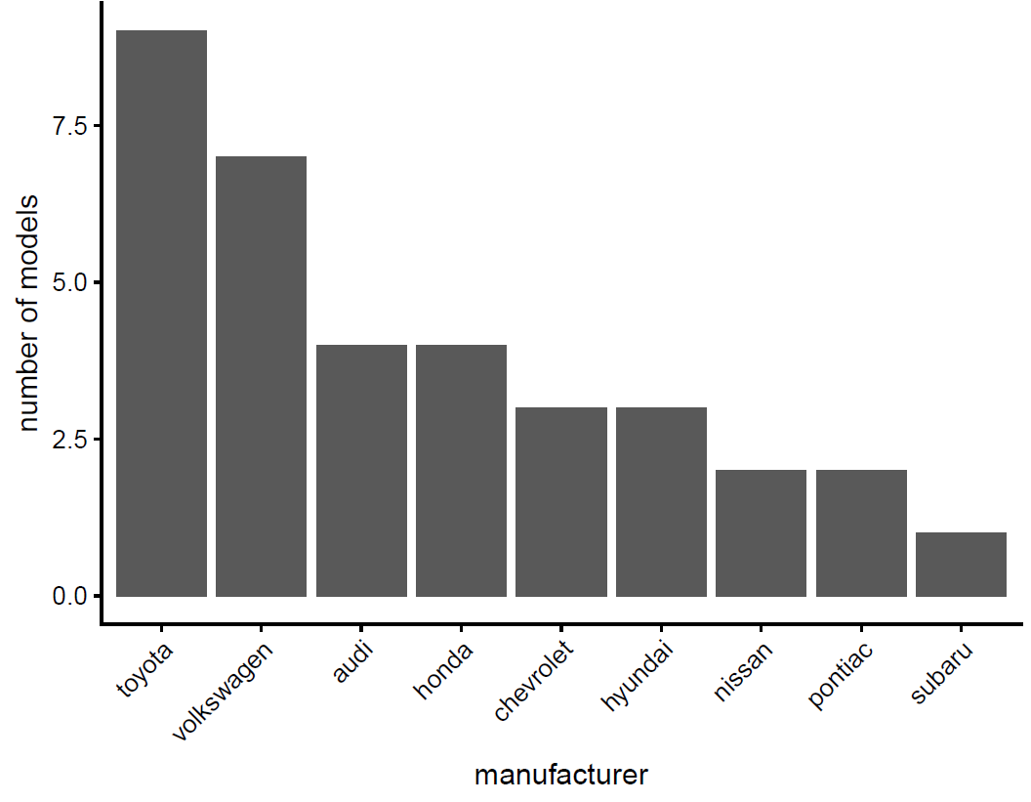
Making it simpler with the pipe
filter(mpg, str_detect(trans, 'auto')) %>%
filter(hwy > quantile(hwy, 0.75)) %>%
count(manufacturer) %>%
ggplot(aes(x=reorder(manufacturer, -n), y=n)) +
geom_bar(stat='identity') +
xlab('manufacturer') +
ylab('number of models') +
theme(axis.text.x=element_text(angle = 45, hjust=1))

Slide 21
Analyzing proliferation data – wrangling, transforming and visualizing
Timelapse proliferation data (Incucyte) of mouse pancreatic cancer cell lines: Incucyte_all.txt
(Thank you to Shuba Narayanan for her data!)
Key points of this experiment are as follows:
Data are measured as percent confluence within each well
Five cell lines total: 12738, 12910, 12962, 12965 and 12969
Cells express either EGFP (negative control) or Ptf1a, a TF that we hypothesize will inhibit their proliferation, inducible with doxycycline (DOX); untreated cells used as controls
3 separate experiments per line, each with 3 technical replicates (i.e. replicate wells) per condition

Slide 22
Load data and take a quick look
data_wide <- read_tsv('Incucyte_all.txt') %>% print()
## # A tibble: 553 x 16
## Line Elapsed Date Experiment EGFP_untreated_1 EGFP_untreated_2
## <dbl> <dbl> <dbl> <dbl> <dbl> <dbl>
## 1 12738 0 180116 1 16.2 13.3
## 2 12738 2 180116 1 18.1 14.6
## 3 12738 4 180116 1 17.5 15.9
## 4 12738 6 180116 1 18.0 16.5
## 5 12738 8 180116 1 18.4 16.9
## 6 12738 10 180116 1 19.4 17.8
## 7 12738 12 180116 1 20.1 17.1
## 8 12738 14 180116 1 21.3 17.6
## 9 12738 16 180116 1 22.3 18.1
## 10 12738 18 180116 1 23.1 19.6
## # … with 543 more rows, and 10 more variables: EGFP_untreated_3 <dbl>,
## # EGFP_DOX_1 <dbl>, EGFP_DOX_2 <dbl>, EGFP_DOX_3 <dbl>,
## # Ptf1a_untreated_1 <dbl>, Ptf1a_untreated_2 <dbl>,
## # Ptf1a_untreated_3 <dbl>, Ptf1a_DOX_1 <dbl>, Ptf1a_DOX_2 <dbl>,
## # Ptf1a_DOX_3 <dbl>
read_tsv automatically reads data into tibble format

Slide 23
gather data from wide format to narrow
data_narrow <- gather(data_wide, key='treatment_group',
value='confluence',
EGFP_untreated_1:Ptf1a_DOX_3) %>%
print()
## # A tibble: 6,636 x 6
## Line Elapsed Date Experiment treatment_group confluence
## <dbl> <dbl> <dbl> <dbl> <chr> <dbl>
## 1 12738 0 180116 1 EGFP_untreated_1 16.2
## 2 12738 2 180116 1 EGFP_untreated_1 18.1
## 3 12738 4 180116 1 EGFP_untreated_1 17.5
## 4 12738 6 180116 1 EGFP_untreated_1 18.0
## 5 12738 8 180116 1 EGFP_untreated_1 18.4
## 6 12738 10 180116 1 EGFP_untreated_1 19.4
## 7 12738 12 180116 1 EGFP_untreated_1 20.1
## 8 12738 14 180116 1 EGFP_untreated_1 21.3
## 9 12738 16 180116 1 EGFP_untreated_1 22.3
## 10 12738 18 180116 1 EGFP_untreated_1 23.1
## # … with 6,626 more rows

Slide 24
Split treatment_group variable into multiple variables with separate
data_narrow <- separate(data_narrow, treatment_group, c('gene', 'treatment', 'rep')) %>%
print()
## # A tibble: 6,636 x 8
## Line Elapsed Date Experiment gene treatment rep confluence
## <dbl> <dbl> <dbl> <dbl> <chr> <chr> <chr> <dbl>
## 1 12738 0 180116 1 EGFP untreated 1 16.2
## 2 12738 2 180116 1 EGFP untreated 1 18.1
## 3 12738 4 180116 1 EGFP untreated 1 17.5
## 4 12738 6 180116 1 EGFP untreated 1 18.0
## 5 12738 8 180116 1 EGFP untreated 1 18.4
## 6 12738 10 180116 1 EGFP untreated 1 19.4
## 7 12738 12 180116 1 EGFP untreated 1 20.1
## 8 12738 14 180116 1 EGFP untreated 1 21.3
## 9 12738 16 180116 1 EGFP untreated 1 22.3
## 10 12738 18 180116 1 EGFP untreated 1 23.1
## # … with 6,626 more rows

Slide 25
Convert treatment into ordered factor
data_narrow <- mutate(data_narrow, treatment=factor(treatment, levels=c('untreated', 'DOX'))) %>%
print()
## # A tibble: 6,636 x 8
## Line Elapsed Date Experiment gene treatment rep confluence
## <dbl> <dbl> <dbl> <dbl> <chr> <fct> <chr> <dbl>
## 1 12738 0 180116 1 EGFP untreated 1 16.2
## 2 12738 2 180116 1 EGFP untreated 1 18.1
## 3 12738 4 180116 1 EGFP untreated 1 17.5
## 4 12738 6 180116 1 EGFP untreated 1 18.0
## 5 12738 8 180116 1 EGFP untreated 1 18.4
## 6 12738 10 180116 1 EGFP untreated 1 19.4
## 7 12738 12 180116 1 EGFP untreated 1 20.1
## 8 12738 14 180116 1 EGFP untreated 1 21.3
## 9 12738 16 180116 1 EGFP untreated 1 22.3
## 10 12738 18 180116 1 EGFP untreated 1 23.1
## # … with 6,626 more rows
This controls plotting order: instead of alphabetically, R will now plot untreated first, then DOX

Slide 26
Let’s make a graph (Figure 1)
ggplot(data_narrow,
aes(x=Elapsed, y=confluence,
group=interaction(Experiment, gene, treatment, rep),
color=interaction(gene, treatment))) +
geom_point(alpha=0.7) +
geom_line(alpha=0.7) +
scale_color_manual(values=c('greenyellow', 'orange', 'green4’,
'orangered3')) +
theme(aspect.ratio=1,
legend.position='top',
legend.title = element_blank(),
legend.text = element_text(size=10)) +
facet_wrap(facets=vars(Line), scales='free')
Plotting every observation as a point, with lines connecting serial observations over time

Slide 27
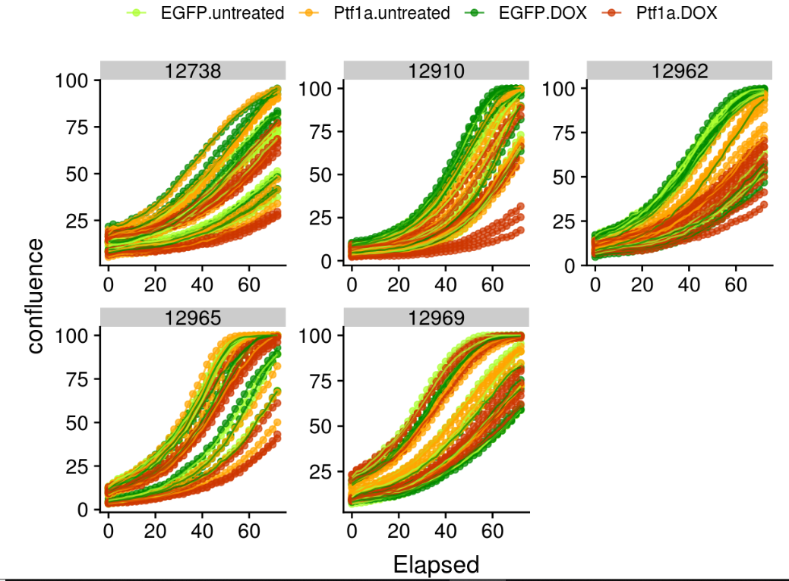
Let’s make a graph (Figure 1)
Wow, much lines, very mess

Slide 28
Let’s combine our technical replicates, and try again
data_mean <- group_by(data_narrow, Line, Experiment, Date,
Elapsed, gene, treatment) %>%
summarize(conf_mean=mean(confluence),
conf_sd=sd(confluence)) %>%
print()
data_mean <- ungroup(data_mean)
## # A tibble: 2,212 x 8
## # Groups: Line, Experiment, Date, Elapsed, gene [1,106]
## Line Experiment Date Elapsed gene treatment conf_mean conf_sd
## <dbl> <dbl> <dbl> <dbl> <chr> <fct> <dbl> <dbl>
## 1 12738 1 180116 0 EGFP untreated 14.2 1.75
## 2 12738 1 180116 0 EGFP DOX 18.6 2.68
## 3 12738 1 180116 0 Ptf1a untreated 14.8 2.54
## 4 12738 1 180116 0 Ptf1a DOX 15.2 0.991
## 5 12738 1 180116 2 EGFP untreated 15.9 1.95
## 6 12738 1 180116 2 EGFP DOX 20.0 2.58
Include all grouping variables in group_by

Slide 29
Let’s make a graph (Figure 2)
ggplot(data_mean, aes(x=Elapsed, y=conf_mean,
group=interaction(Experiment, gene, treatment),
color=interaction(gene, treatment))) +
geom_point(alpha=0.7) +
geom_line(alpha=0.7) +
geom_errorbar(aes(ymin=conf_mean-conf_sd, ymax=conf_mean+conf_sd)) +
scale_color_manual(values=c('greenyellow', 'orange’,
'green4', 'orangered3')) +
expand_limits(y=0) +
theme(aspect.ratio=1,
legend.position='top',
legend.title = element_blank(),
legend.text = element_text(size=10)) +
facet_wrap(facets=vars(Line), scales='free')
Plotting mean confluence values as connected points, with error bars indicating SD of technical replicates

Slide 30
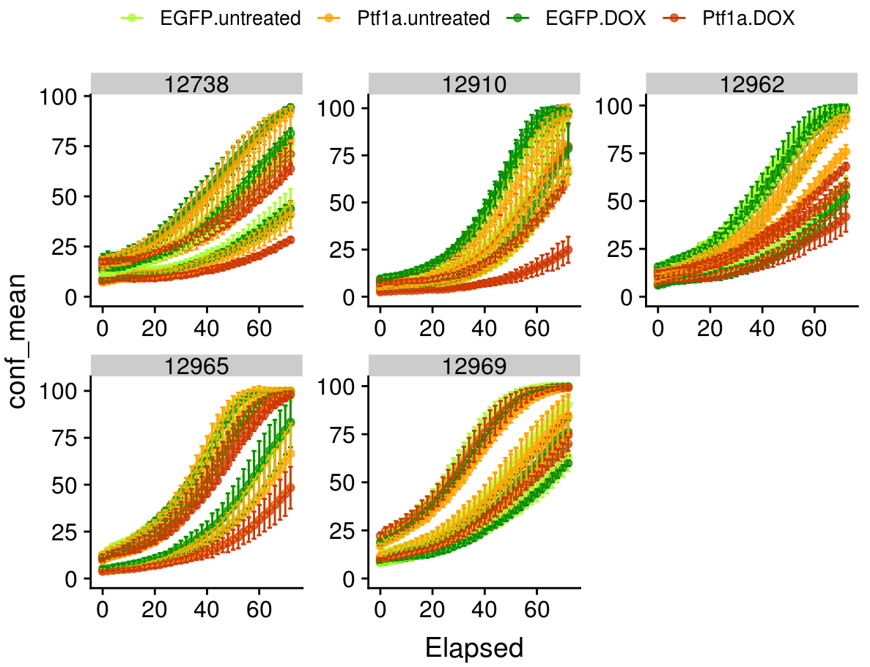
Let’s make a graph (Figure 2)
Cleaner-looking, but still a lot of inconsistency in the data

Slide 31
filter data to look only at start and end of experiment
Does inconsistency reflect different starting points from experiment to experiment, i.e. difference confluence at time=0?
filter(data_mean, Elapsed == min(Elapsed)| Elapsed==max(Elapsed)) %>%
ggplot(aes(x=Elapsed, y=conf_mean,
group=interaction(Experiment, gene, treatment),
color=interaction(gene, treatment))) +
geom_point() +
geom_line() +
scale_color_manual(values=c('greenyellow', 'orange’,
'green4', 'orangered3')) +
expand_limits(y=0) +
theme(aspect.ratio=1,
legend.position='top’,
legend.title = element_blank(),
legend.text = element_text(size=10)) +
facet_wrap(facets=vars(Line), scales='free')

Slide 32
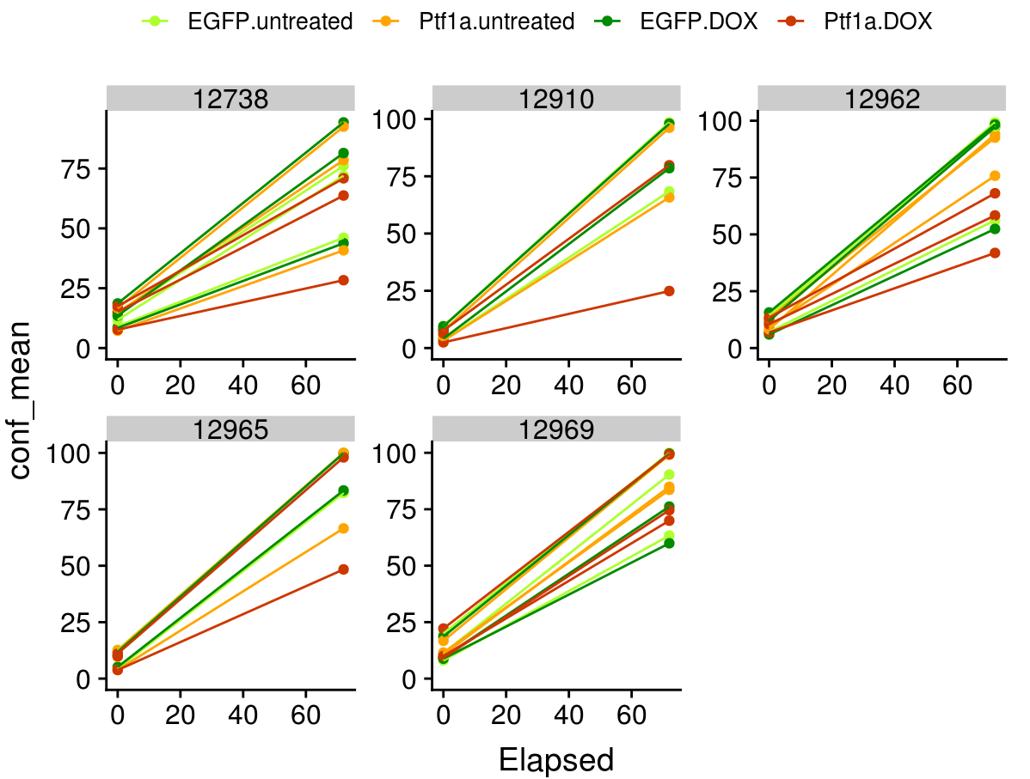
Graph of filtered data
Inconsistency at t=0 suggests we might transform data by normalizing each experiment to this timepoint

Slide 33
Steps for transforming our data
Use filter to create a new data frame containing the t=0 data, baseline, with conf_mean renamed to initial
Merge baseline into data_mean data frame via inner_join - this will add the t=0 confluence as a new column, initial
Create fold-normalized confluence by dividing conf_mean by initial - similar operation for standard deviation values
Graph the results

Slide 34
Add initial confluence values to data frame
baseline <- filter(data_mean, Elapsed==0) %>%
rename(initial=conf_mean) %>%
select(-Elapsed, -conf_sd, -conf_cv) %>% print()
## # A tibble: 60 x 6
## Line Experiment Date gene treatment initial
## <dbl> <dbl> <dbl> <chr> <fct> <dbl>
## 1 12738 1 180116 EGFP untreated 14.2
## 2 12738 1 180116 EGFP DOX 18.6
## 3 12738 1 180116 Ptf1a untreated 14.8
## 4 12738 1 180116 Ptf1a DOX 15.2
## 5 12738 2 180120 EGFP untreated 9.10
data_fold <- inner_join(data_mean, baseline) %>% print()
## # A tibble: 2,212 x 10
## Line Experiment Date Elapsed gene treatment conf_mean conf_sd initial
## <dbl> <dbl> <dbl> <dbl> <chr> <fct> <dbl> <dbl> <dbl>
## 1 12738 1 180116 0 EGFP untreated 14.2 1.75 14.2
## 2 12738 1 180116 0 EGFP DOX 18.6 2.68 18.6
## 3 12738 1 180116 0 Ptf1a untreated 14.8 2.54 14.8
## 4 12738 1 180116 0 Ptf1a DOX 15.2 0.991 15.2
## 5 12738 1 180116 2 EGFP untreated 15.9 1.95 14.2

Slide 35
Calculate fold-change in confluence
data_fold <- mutate(data_fold, fold=conf_mean/initial,
fold_sd=conf_sd/initial) %>%
print()
# A tibble: 2,212 x 12
Line Experiment Date Elapsed gene treatment conf_mean conf_sd conf_cv initial fold fold_sd
<dbl> <dbl> <dbl> <dbl> <chr> <fct> <dbl> <dbl> <dbl> <dbl> <dbl> <dbl>
1 12738 1 180116 0 EGFP untreated 14.2 1.75 0.123 14.2 1 0.123
2 12738 1 180116 0 EGFP DOX 18.6 2.68 0.144 18.6 1 0.144
3 12738 1 180116 0 Ptf1a untreated 14.8 2.54 0.172 14.8 1 0.172
4 12738 1 180116 0 Ptf1a DOX 15.2 0.991 0.0654 15.2 1 0.0654
5 12738 1 180116 2 EGFP untreated 15.9 1.95 0.123 14.2 1.12 0.137
Now let’s plot the fold-change over time

Slide 36
Figure 3 – fold as a function of Elapsed
ggplot(data_fold, aes(x=Elapsed, y=fold,
group=interaction(Experiment, gene, treatment),
color=interaction(gene, treatment))) +
geom_point(alpha=0.7) +
geom_line(alpha=0.7) +
geom_errorbar(aes(ymin=fold-fold_sd, ymax=fold+fold_sd)) +
scale_color_manual(values=c('greenyellow', 'orange', 'green4’,
'orangered3')) +
expand_limits(y=0) +
theme(aspect.ratio=1) +
ylab('net growth') +
theme(aspect.ratio=1,
legend.position='top',
legend.title = element_blank(),
legend.text = element_text(size=10)) +
facet_wrap(facets=vars(Line), scales='free')

Slide 37
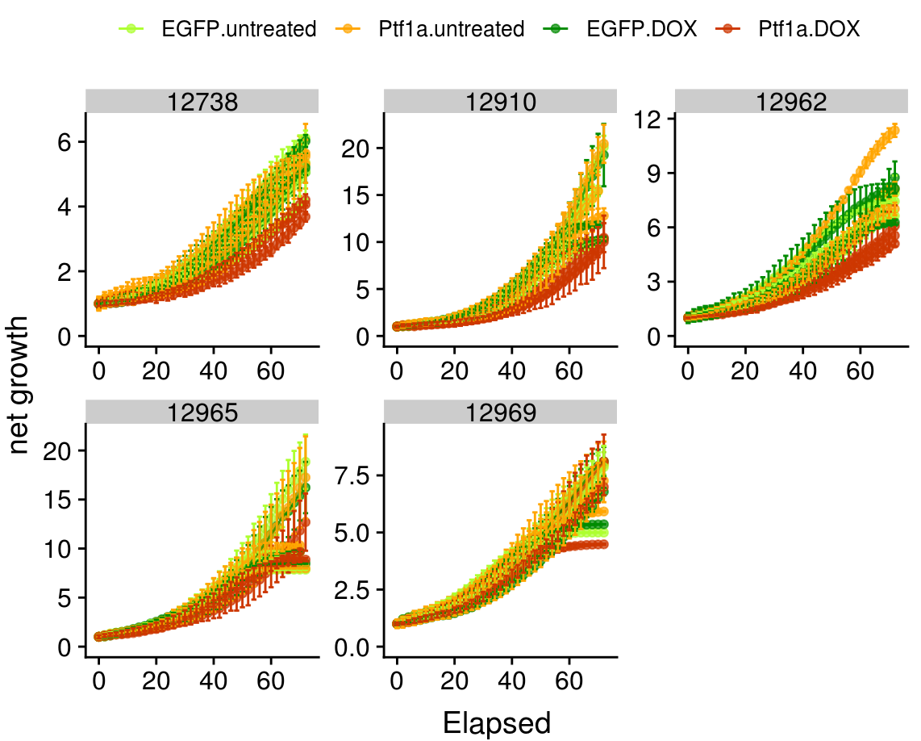
Figure 3 – fold as a function of Elapsed

Slide 38
Summarizing results across experiments
data_fold_mean <- group_by(data_fold, Line, Elapsed, gene, treatment) %>%
summarize(fold_mean=mean(fold),
fold_mean_sd=sd(fold)) %>%
print()
ungroup(data_fold_mean)
## # A tibble: 740 x 6
## # Groups: Line, Elapsed, gene [370]
## Line Elapsed gene treatment fold_mean fold_mean_sd
## <dbl> <dbl> <chr> <fct> <dbl> <dbl>
## 1 12738 0 EGFP untreated 1 0
## 2 12738 0 EGFP DOX 1 0
## 3 12738 0 Ptf1a untreated 1 0
## 4 12738 0 Ptf1a DOX 1 0
## 5 12738 2 EGFP untreated 1.06 0.0546
## 6 12738 2 EGFP DOX 1.03 0.0364
## 7 12738 2 Ptf1a untreated 1.09 0.0460
## 8 12738 2 Ptf1a DOX 1.07 0.0507
## 9 12738 4 EGFP untreated 1.09 0.0450
## 10 12738 4 EGFP DOX 1.04 0.0261
## # … with 730 more rows

Slide 39
Figure 4 –mean fold-change between experiments
ggplot(data_fold_mean, aes(x=Elapsed, y=fold_mean,
group=interaction(gene, treatment),
color=interaction(gene, treatment))) +
geom_point(alpha=0.7) +
geom_line(alpha=0.7) +
geom_errorbar(aes(ymin=fold_mean-fold_mean_sd,
ymax=fold_mean+fold_mean_sd)) +
scale_color_manual(values=c('greenyellow', 'orange', 'green4’,
'orangered3')) +
expand_limits(y=0) +
theme(aspect.ratio=1) +
ylab('net growth') +
theme(aspect.ratio=1,
legend.position='top',
legend.title = element_blank(),
legend.text = element_text(size=10)) +
facet_wrap(facets=vars(Line), scales='free')

Slide 40
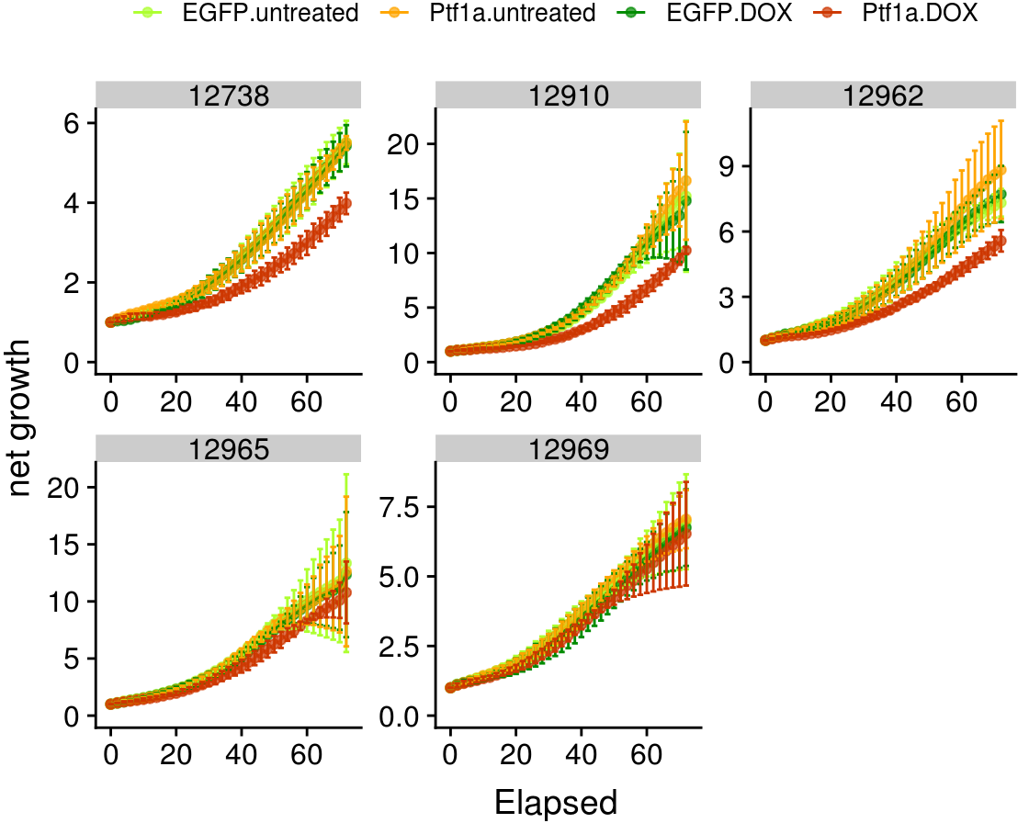
Figure 4 –mean fold-change between experiments

Slide 41
The final result – not bad considering where we started
Many caveats to consider, but data processing pipeline holds up, as do main overall conclusions

